Slide 1
Review – Current Condition
Ongoing Conservation
Management
Environmental Stressor 1
Habitat
Demographics
Population Resilience
Environmental Stressor 2
Exotic Species
(Other Stressors)
Unpredictable Systematic Change (e.g., Climate Change)
Notes:
Briefly review the three Ecological Setting 11x17 Population Resilience influence diagrams that were developed yesterday afternoon.
Similarities?
Differences?
Questions?

Slide 2



Review – Current Condition
Coastal Populations
Beach Bums
Message in a Bottle (MIB)
Cannibal Cove
Castaways
Paradise Palm Populations
Snowmelt Thicket
Dead Man Dunes
Treasure Grove
Realm of Spirits
Mountain Populations
Misty Mountain
Darlost’s Dome
Notes:
Remind class about Representation and Redundancy

Slide 3

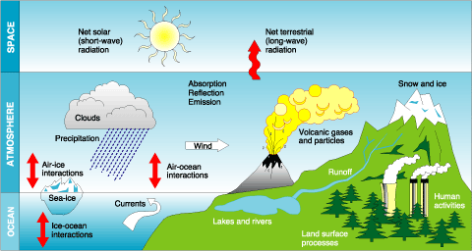
Review – Current Condition
Notes:
What were some of the stressors that you felt were MOST influencing the Island Mouse’s current condition? This conceptual model diagram is just another example of how you can graphically portray the relationships between the stressors and important habitat metrics.

Slide 4
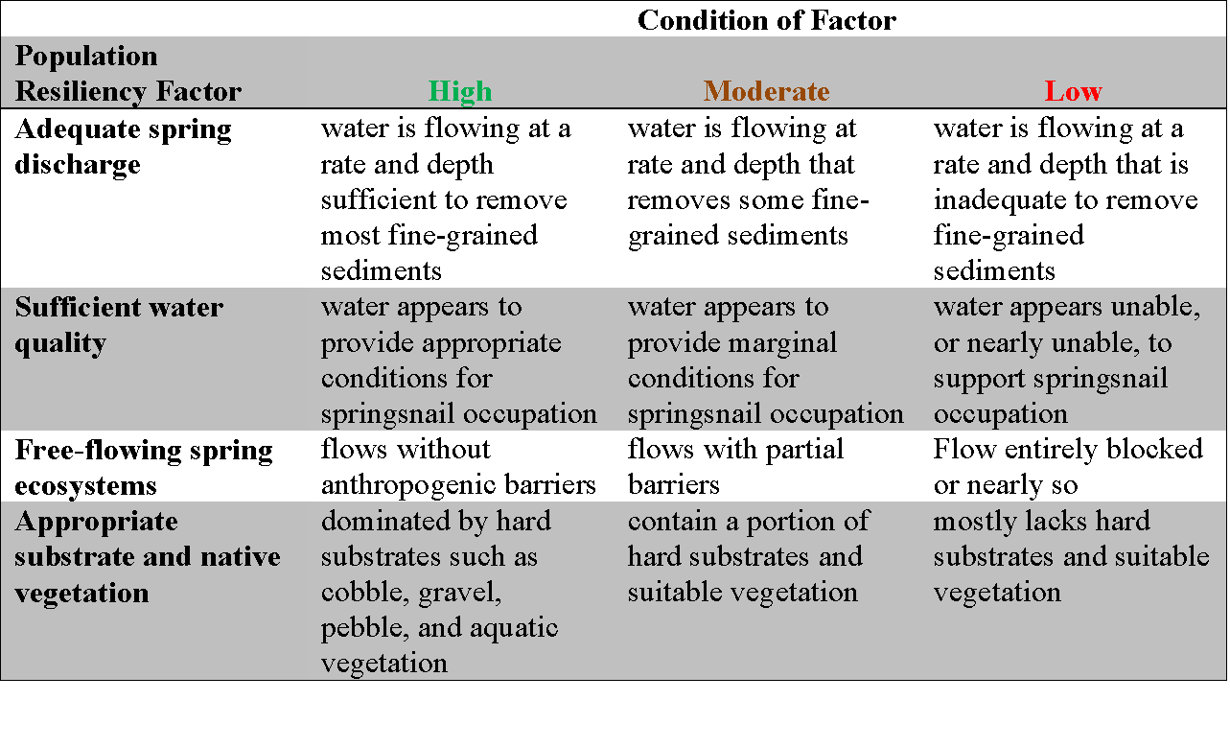
Assessing the Factors
Current Condition

Slide 5
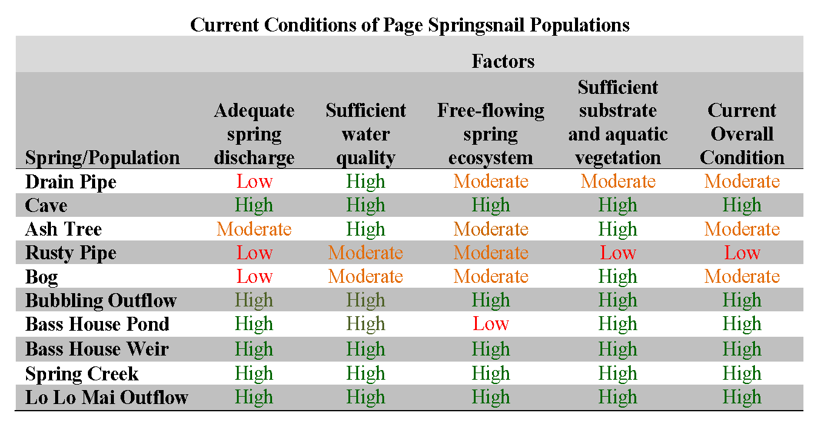
Current Condition
Notes:
Based on analysis of habitat, six populations currently are in high condition (i.e., high resilience and low risk of extirpation), three in moderate condition (i.e., moderate resilience), and one in low condition (i.e., low resilience, high risk of extirpation).

Slide 6
Current Condition
Redundancy: Multiple populations throughout the range of the species
Representation: Maintain existing genetic variation as a proxy for unknown ecological variation

Slide 7
Current Condition
Resiliency: the capacity of a population to withstand stochastic disturbance events
Thus, there is a probabilistic element
A goal is to apply a commonly understood language for discussing uncertainty and probability
(Mastranrea et al. 2011. The IPCC AR5 guidance note on consistent treatment of uncertainties: common approach across working groups. Climatic Change)
Notes:
Resiliency is inherently a probabilistic statement regarding the chance that a population will withstand stochastic disturbance events. Statements about probability may include linguistic uncertainty (borderline cases or ambiguities) so it may be hard to know the statement’s meaning (Burgman 2016).
Sherman Kent an intelligence analyst in the 1960’s observed that people used words for probabilities with drastically different meaning. Term ‘serious probability’ of an event meant a 20% chance to some and an 80% chance to others. Kent realized that there was a great need to calibrate terminology to achieve a common understanding and reduce linguistic uncertatinty.

Slide 8
Current Condition
Fill out this table and compare to others
Phrase | Numerical Probability | Range
High Probability
Not very probable
Seldom
Quite Likely
Rare
Rather Likely
Good Chance
Uncertain
Notes:
Take a minute and let’s gauge what we mean when we use words for probability. Pick a few phrases and indicate the numerical probability and range in probabilities when you use that phrase.
(give 3 min and then ask for responses. Ask for multiple responses for the same phrase to compare and contrast. Draw a connection to terms used in the SSA.)

Slide 9
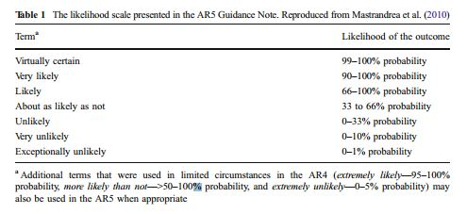
Current Condition
IPCC probability table
Notes:
IPCC went through a LOT of turmoil to get this scale defined. (elaborate if appropriate)
Sherman Kent, the intelligence analyst, spearheaded the use of “calibrated terminology” to reduce linguistic uncertainty in probability statements. The tables he developed linked probability terms to likelihood of outcomes to which they refer. These were called “Kent scales”. IPCC recognized the need to calibrate their terminology and formed a work group to develop their own “Kent scale” as a guide.
FOR OUR PURPOSES HERE, we are going to use this scale. The purpose is for us to be clear and consistent on what we mean.
You will be using this scale in the exercises coming up…

Slide 10
Recall resiliency categories
Current Condition
Notes:
Recall the resiliency categories and terminology used to describe current condition of Page springsnail populations. Although these are defined by an explicit narrative, the categories lack an explicit association with risk level. For example, how does ‘high’ overall condition relate to resilience? What does “high resilience” mean to you? Does it mean the same thing to everyone? Is the use of the term calibrated?

Slide 11
A calibrated language for risk
Current Condition
Overall condition based on resiliency | Risk | Persistence | Probability of persistence
Very high | Virtually no risk | Virtually certain | 99-100%
High | Low | Very likely | 90-100%
Moderate | Moderate | Likely | 66-90%
Low | High | About as likely as not and unlikely | 0-66%
Very low | Very high | Very unlikely | 0-10%
Notes:
D. Smith Notes:
Clearly, the SSA needs a calibrated language to talk about species risk or, the flip side, persistence. Here’s a draft SSA “Kent scale”. The resilience categories are defined to match the risk category and persistence. No data is needed to define categories; the definitions simply clarify what is meant when terms are used, such as, ‘high’, ‘moderate’, or ‘low’. Data, knowledge, or expert judgment are needed to specify the factor levels that correspond to overall condition (see table on previous slide) and to estimate current and future condition.
The SSA “Kent scale” can be revised, but should be used consistently within an SSA and ideally within all SSAs.
Under this approach, the resilience categories are defined to match the risk category.
(Notice there are MORE condition categories here than in the Page Springsnail example. That is OK!!! It is additional layers of refinement…maybe that would result in a higher degree of detail. No two are alike…do what is best in your situation!)
(This has clearly been thought through in advance…not as an afterthought! Figure it out BEFORE you start trying to describe your current condition.)

Slide 12
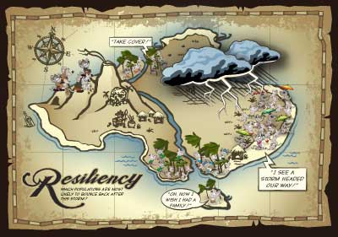
Current Condition
EXERCISE 8.
Species Resilience
Notes:
Describe current condition for your mouse population given agreed upon resilience metric(s) and add your results to the table and map for the species’ current condition. Rank the populations by level of resilience. Characterize redundancy within each representative area.
Exercise 8 starts out as a class group, working together to define high, moderate and low language for population and habitat factors. The instructor leads the group through coming up with the definitions that go in the boxes in the Table on page 15.
After everyone has a common understanding of what high, moderate, and low is, go into population groups and assess the current condition of each population for all of the population and habitat factors. Transcribe onto the wall poster (copy everyone else’s, too), and then answer the questions on pages 16 & 17.

